Slide 1
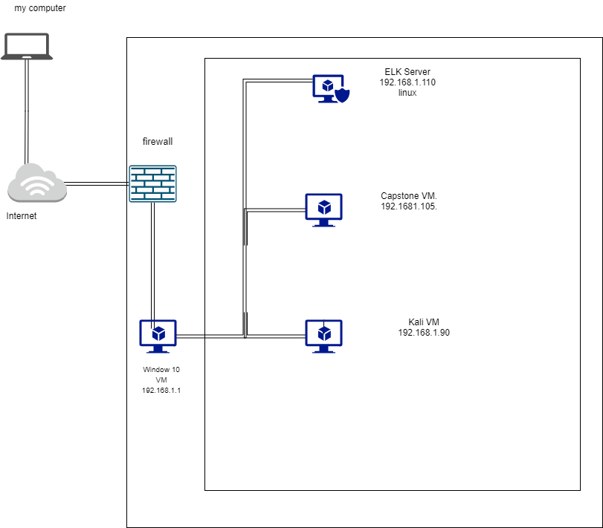
Network Topology
Network
Address Range: 1-255
Netmask:255.255.255.0
Gateway:192.168.1.1
Machines
IPv4:192.168.1.100
OS: Linux
Hostname:ELK
IPv4:192.168.1.105
OS:linux
Hostname:capstone
IPv4:192.168.1.90
OS:Linux
Hostname:Kali
IPv4:192.168.1.1
OS:Windows 10
Hostname:ML-RefVm-684427

Slide 2

Red Team
Security Assessment
‹#›

Slide 3
Recon: Describing the Target
Nmap identified the following hosts on the network:
Hostname | IP Address | Role on Network
ML-RefVm-684427 | 192.168.1.1 | Windows Remote VM with hypervisor
kali | 192.168.1.90 | Attacker machine
capstone | 192.168.10105 | Vulnerable Target machine
Elk | 192.168.1.100 | SIEM VM for lab Environment

Slide 4
Vulnerability Assessment
The assessment uncovered the following critical vulnerabilities in the target:
Vulnerability | Description | Impact
Use the CVE number if it exists. Otherwise, use the common name. | Describe the vulnerability. | Describe what this vulnerability allows the attacker to do.
NMAP port scanning enabled | I was able to see all the open ports without restriction, when i run the Nmap. | The attacker is able to gain access to the target machine due to knowing type of servers and information about the target machine.
Hydra Brute force | I was able to run Hydra nonstop to get as much information as I could | No alerts or security measures means I can endlessly force entry into the target resources
Easily cracked hashes and weak passwords | Readily available wordlists can crack the weak hashes used by personnel | It only takes one weak password to gain access and allow time to sniff out administrative control

Slide 5
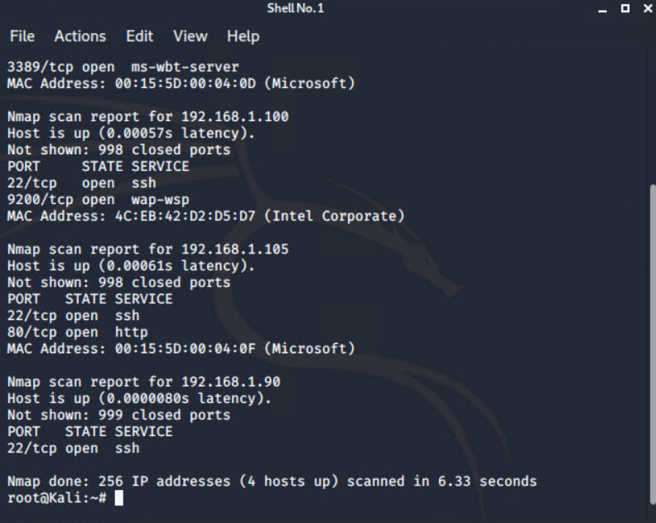
Exploitation: NMAP Scanning]
01
02
03
Tools & Processes
Detailed NMAP scan of the capstone VM showed ports 22 port and 80 open and other ports as well
Port 80 was chosen as the most interesting to place start
Achievements
The exploit achieved information about the target machine, such as type of server and model of the OS. and this is the best way to gain access to the target machine.

Slide 6
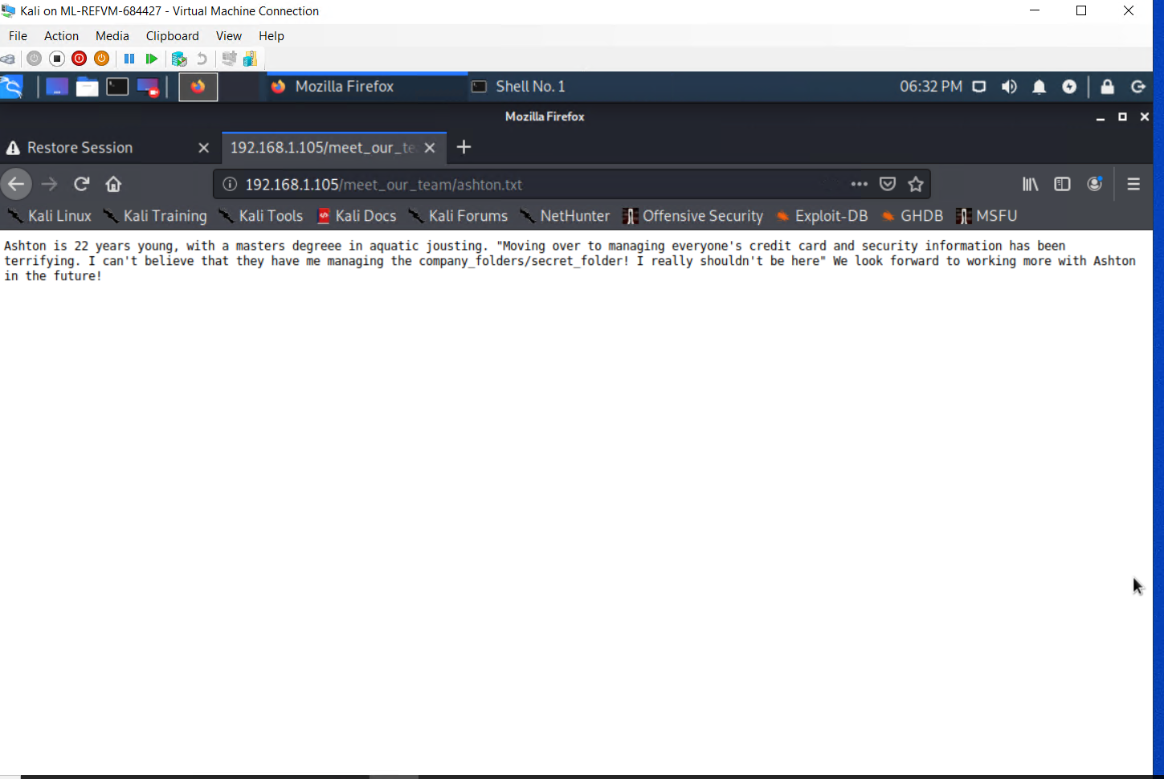
Exploitation: [Hydra Brute Force]
01
02
03
Tools & Processes
Hydra was used to access brute force account by using admin credentials.
Achievements
I was able to access to webserve secret folder . that secret folder provider information that i can use to gain additional resources.
[INSERT: screenshot or command output illustrating the exploit.]

Slide 7
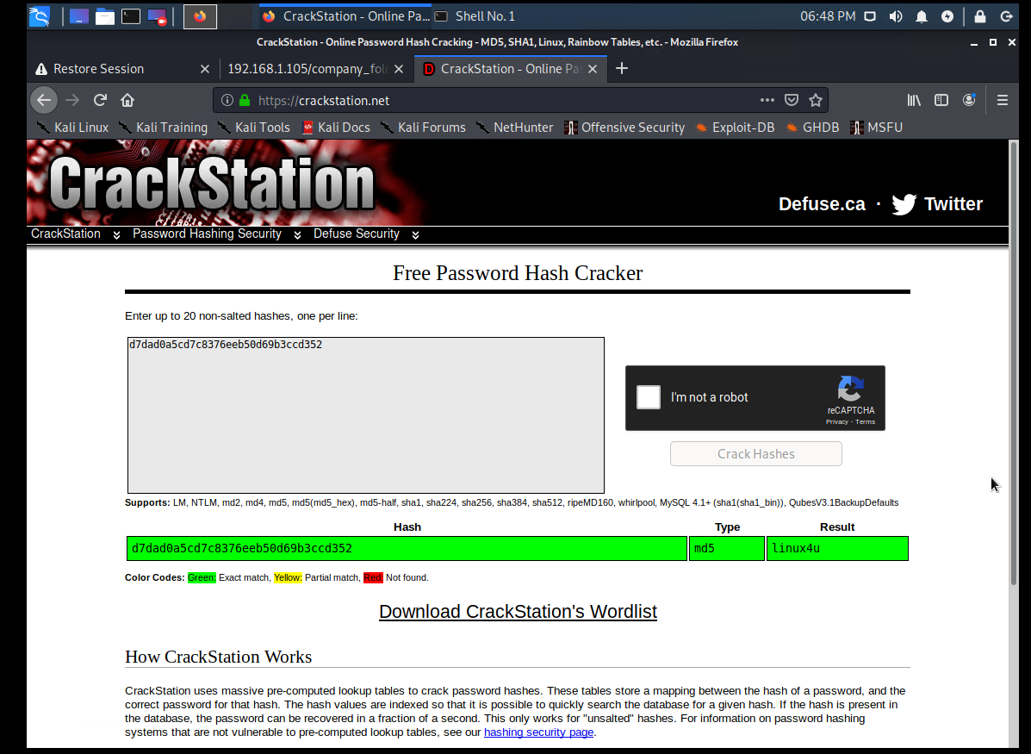
Exploitation: [weak passwords and hashes]
01
02
03
Tools & Processes
John the Ripper can easily crasily crack simple hashes.
Achievements
John the Ripper give access to network share for web server where malicious payload was deliver and give me a shell on the box

Slide 8

Blue Team
Log Analysis and Attack Characterization
‹#›

Slide 9
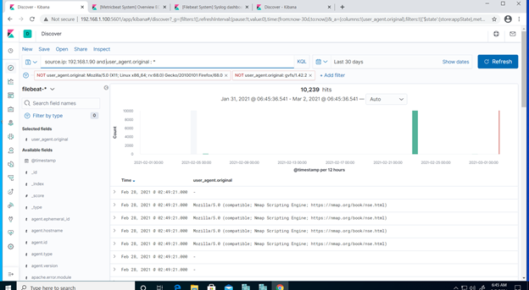
Analysis: Identifying the Port Scan
What time did the port scan occur? 02/28/21 @ 2:49
How many packets were sent, and from which IP? 10,239
What indicates that this was a port scan? User_Agent NMAP scripting engine used

Slide 10
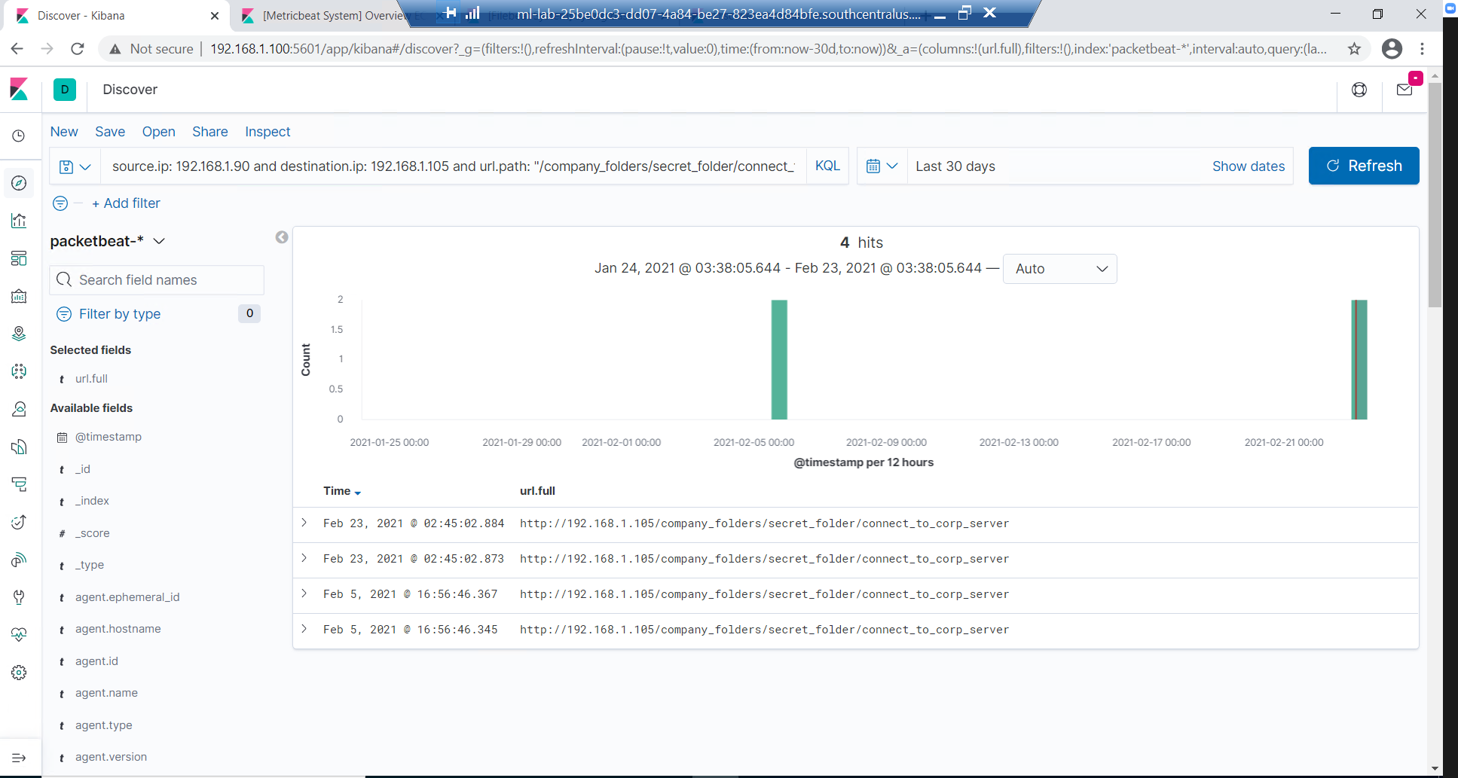
Analysis: Finding the Request for the Hidden Directory
What time did the request occur? 02/23/21 @ 2:45. How many requests were made? 4
Which files were requested? Connect_to_ corp_server. What did they contain? It contain Ryan’s hash and directions.
[Insert Here]
Include a screenshot of Kibana logs depicting the request for the hidden directory.

Slide 11
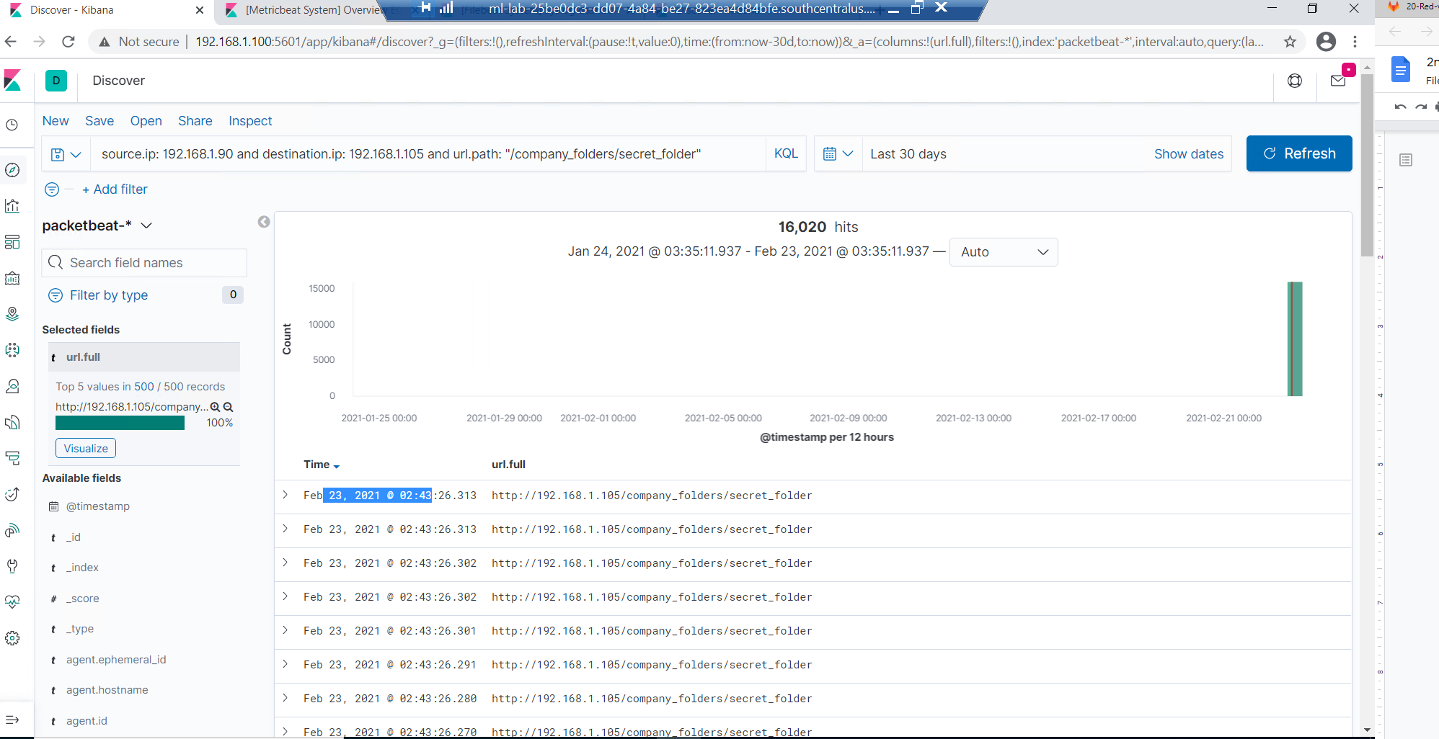
Analysis: Uncovering the Brute Force Attack
How many requests were made in the attack? 16020 hits
How many requests had been made before the attacker discovered the password? 16019

Slide 12
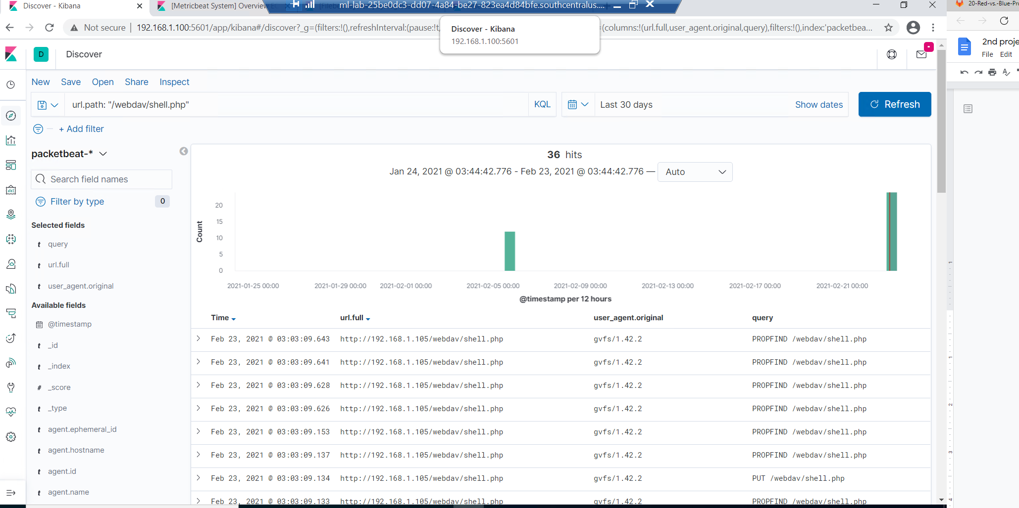
Analysis: Finding the WebDAV Connection
How many requests were made to this directory?36 hits
Which files were requested? shell.php
[Insert Here]
Add a screenshot of Kibana logs depicting the WebDAV connection.

Slide 13
Blue Team
Proposed Alarms and Mitigation Strategies
‹#›

Slide 14
Mitigation: Blocking the Port Scan
What kind of alarm can be set to detect future port scans?
Trigger an alert when ports other than 80 receive packets of data
What threshold would you set to activate this alarm?
5 packets within 1 minute to any port other then 80
What configurations can be set on the host to mitigate port scans?
Configure ICMP echo request and reply to block or drop all traffic
Describe the solution. If possible, provide required command lines.
Syntax depends on specific appliance being configured. Likely cloud based deployment needed

Slide 15
Mitigation: Finding the Request for the Hidden Directory
What kind of alarm can be set to detect future unauthorized access?
Alert to trigger when remote access to protected folders is deleted.
What threshold would you set to activate this alarm?
I would set this alarm, any packet that come should be alert the SOC team.
What configuration can be set on the host to block unwanted access?
The system should not allow remote access to any secret folder or protect folders to be access other than admin team.
Describe the solution. If possible, provide required command lines.
Web Server can only be allowed to specific files that is intended for remote access

Slide 16
Mitigation: Preventing Brute Force Attacks
What kind of alarm can be set to detect future brute force attacks?
Alert trigger packets coming from ip address that is unknown as well as outside local network
What threshold would you set to activate this alarm?
About 80-90 packets from legitimate ip address within 1 minutes
What configuration can be set on the host to block brute force attacks?
Patched or block any ip addresses that is unknown.
Describe the solution. If possible, provide the required command line(s).
Configure network security group as well as the cloud security and block it any suspect issues.

Slide 17
Mitigation: Detecting the WebDAV Connection
What kind of alarm can be set to detect future access to this directory?
Alert to trigger if there is numerous resource outside of website data.
What threshold would you set to activate this alarm?
This alarm should be set to zero.
What configuration can be set on the host to control access?
Ryan and Ashton did not do well on their job. Both need to be replace to someone who is more skillful as well as get the job secure.
Describe the solution. If possible, provide the required command line(s).
Ryan and Ashton should be searched thoroughly, before they leave the building and security should escort them.

Slide 18
Mitigation: Identifying Reverse Shell Uploads
What kind of alarm can be set to detect future file uploads?
All files that end txt. Or pdf
What threshold would you set to activate this alarm?
The alarm should set to zero.
What configuration can be set on the host to block file uploads?
Files should be prioritized to webdav
Describe the solution. If possible, provide the required command line.
Be able to managed or configured to scan files on-going different networking.

